Slide 1
Dystopias
Definition and Characteristics

Slide 2

Utopia: A place, state, or condition that is ideally perfect in respect of politics, laws, customs, and conditions.
Dystopia: A futuristic, imagined universe in which oppressive societal control and the illusion of a perfect society are maintained through corporate, bureaucratic, technological, moral, or totalitarian control. Dystopias, through an exaggerated worst-case scenario, make a criticism about a current trend, societal norm, or political system.

Slide 3
Characteristics of a Dystopian Society
Propaganda is used to control the citizens of society.
Information, independent thought, and freedom are restricted.
A figurehead or concept is worshipped by the citizens of the society.
Citizens are perceived to be under constant surveillance.
Citizens have a fear of the outside world.
Citizens live in a dehumanized state.
The natural world is banished and distrusted.
Citizens conform to uniform expectations. Individuality and dissent are bad.
The society is an illusion of a perfect utopian world.

Slide 4
Types of Dystopian Controls
Most dystopian works present a world in which oppressive societal control and the illusion of a perfect society are maintained through one or more of the following types of controls:

Slide 5
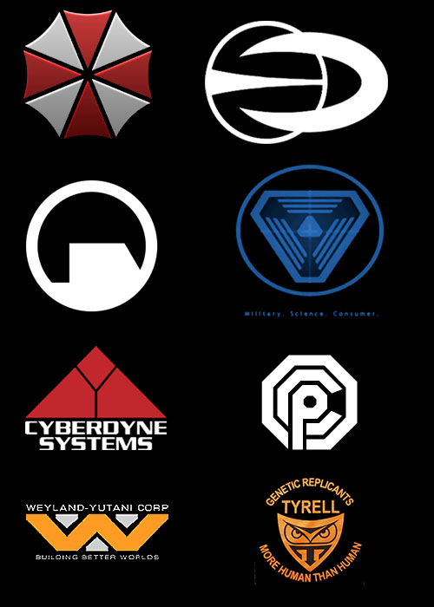
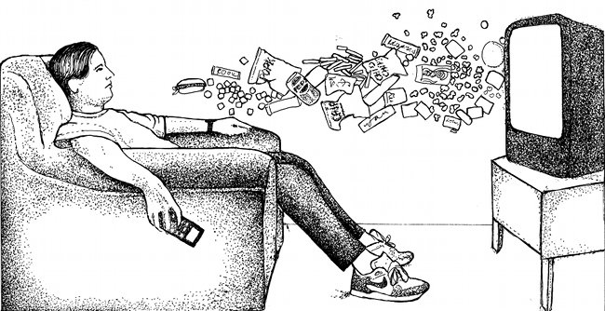
Corporate control:
One or more large corporations control society through products, advertising, and/or the media. Examples include Minority Report and Running Man

Slide 6
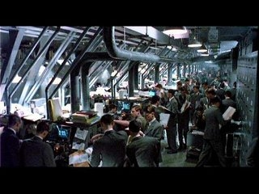
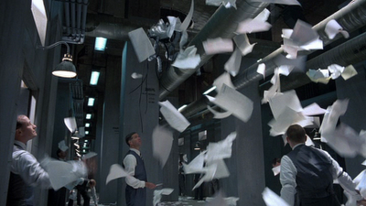
Bureaucratic control:
Society is controlled by a mindless bureaucracy through a tangle of red tape, relentless regulations, and incompetent government officials. Examples in film include Brazil.

Slide 7
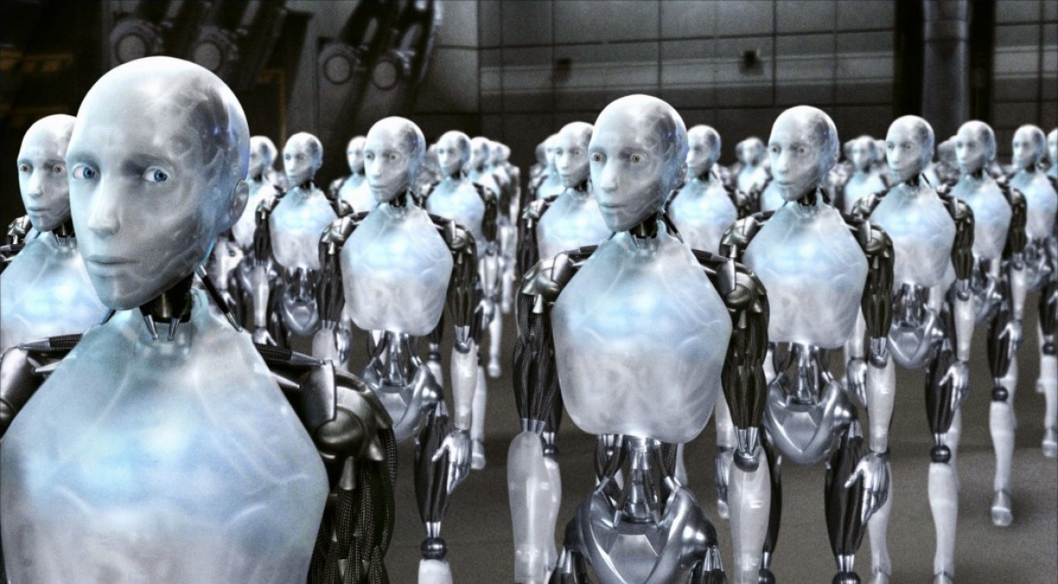
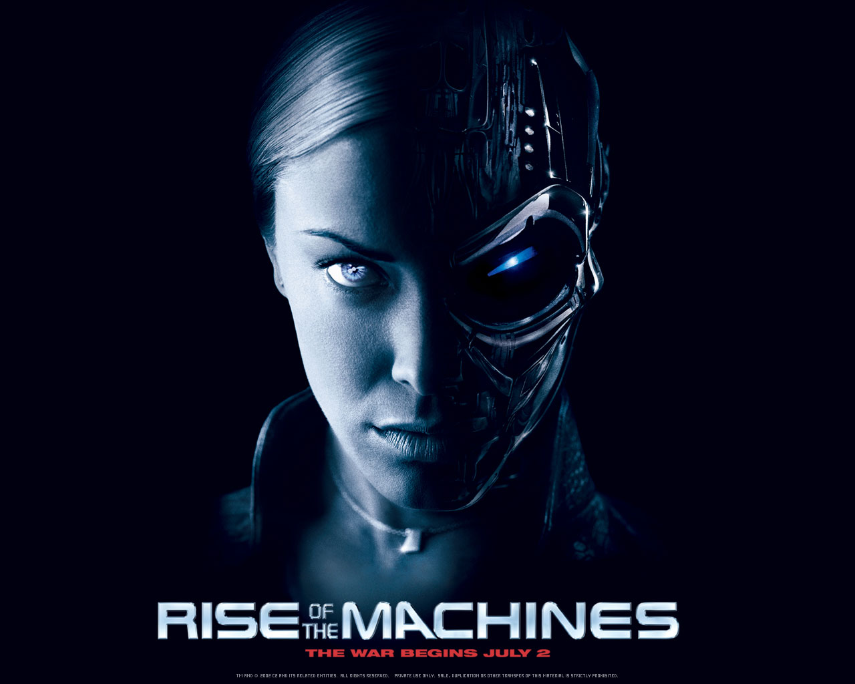
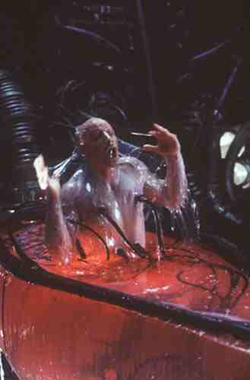
Technological control:
Society is controlled by technology—through computers, robots, and/or scientific means. Examples include The Matrix, The Terminator, and I, Robot.

Slide 8
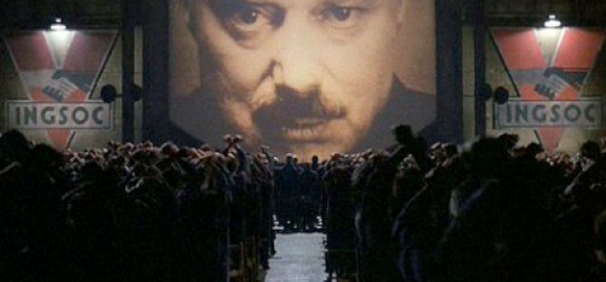
Philosophical/religious control:
Society is controlled by philosophical or religious ideology often enforced through a dictatorship or theocratic government.

Slide 9

The Dystopian Protagonist
often feels trapped and is struggling to escape.
questions the existing social and political systems.
believes or feels that something is terribly wrong with the society in which he or she lives.
helps the audience recognizes the negative aspects of the dystopian world through his or her perspective.

Slide 10
Best School!

Slide 11
Worst School

